Slide 1
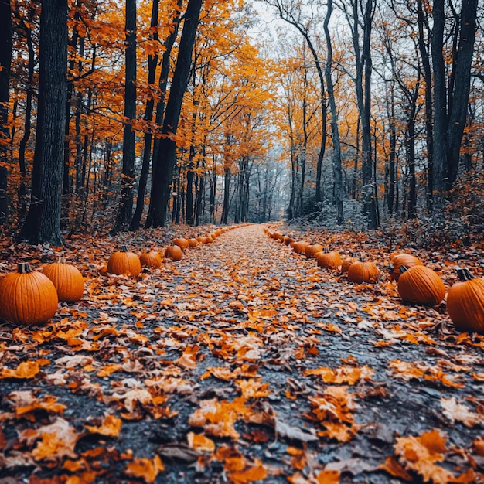


Slide 2
When: lunchtimes
Where: corridor outside the assembly hall

Slide 3


KS2 BOOKS

Slide 4
KS3 BOOKS
Year 8 pupils can buy 13+ books if they have written permission from a parent or carer and the book title signed in their planner.

Slide 5




KS3

Slide 6


KS3

Slide 7
Books can be purchased from the book fair with cash or pre-paid vouchers.
Pre-paid vouchers are available to purchase via the following link:
www.bookfairs.scholastic.co.uk/gift-vouchers

Slide 8
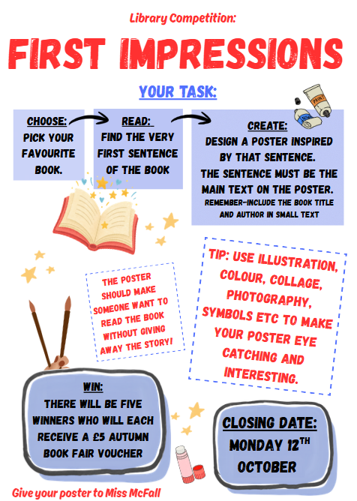
COMPETITION
There is still time to enter the ‘First Impressions’ library competition.
There will be FIVE lucky winners, who will each receive a £5 voucher to spend at the Book Fair!
Closing date: Monday 12th October

