Slide 1


School Council
Caring for our school, community and the environment

Slide 2

All about giving pupils a voice
Suggesting changes that will help pupils
Thinking about the environment
Working to help our community

Slide 3


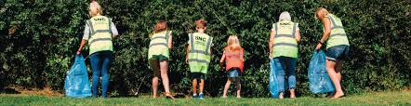
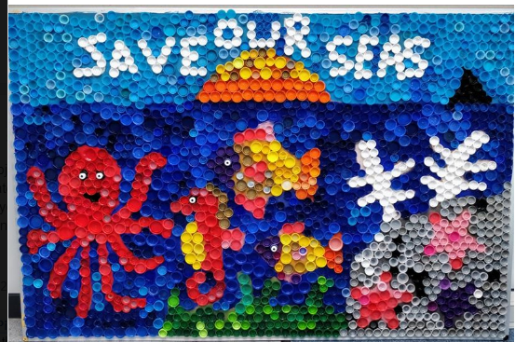
Our environment is so important!
The School Council can help with ideas.

Slide 4
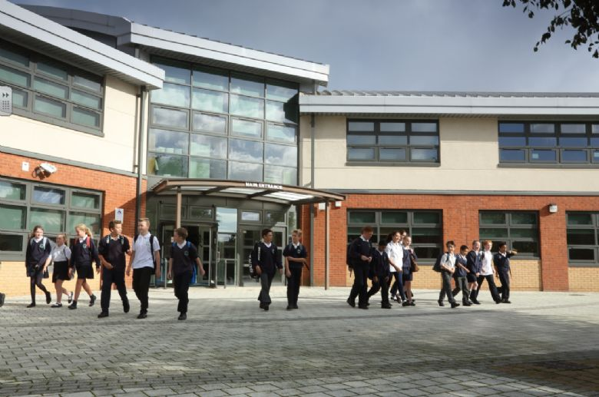
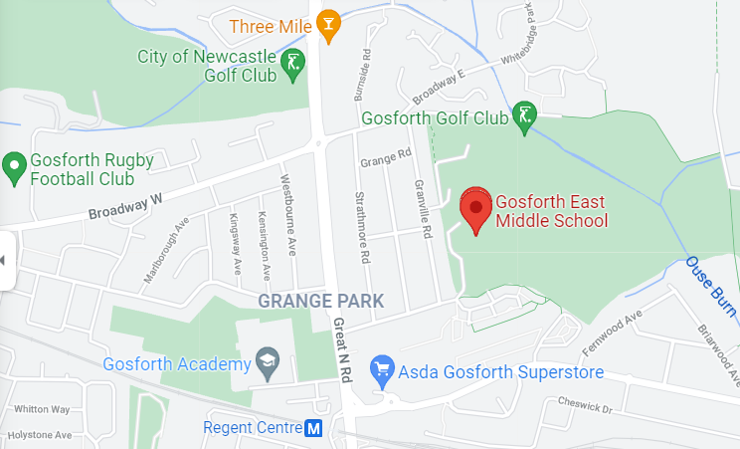
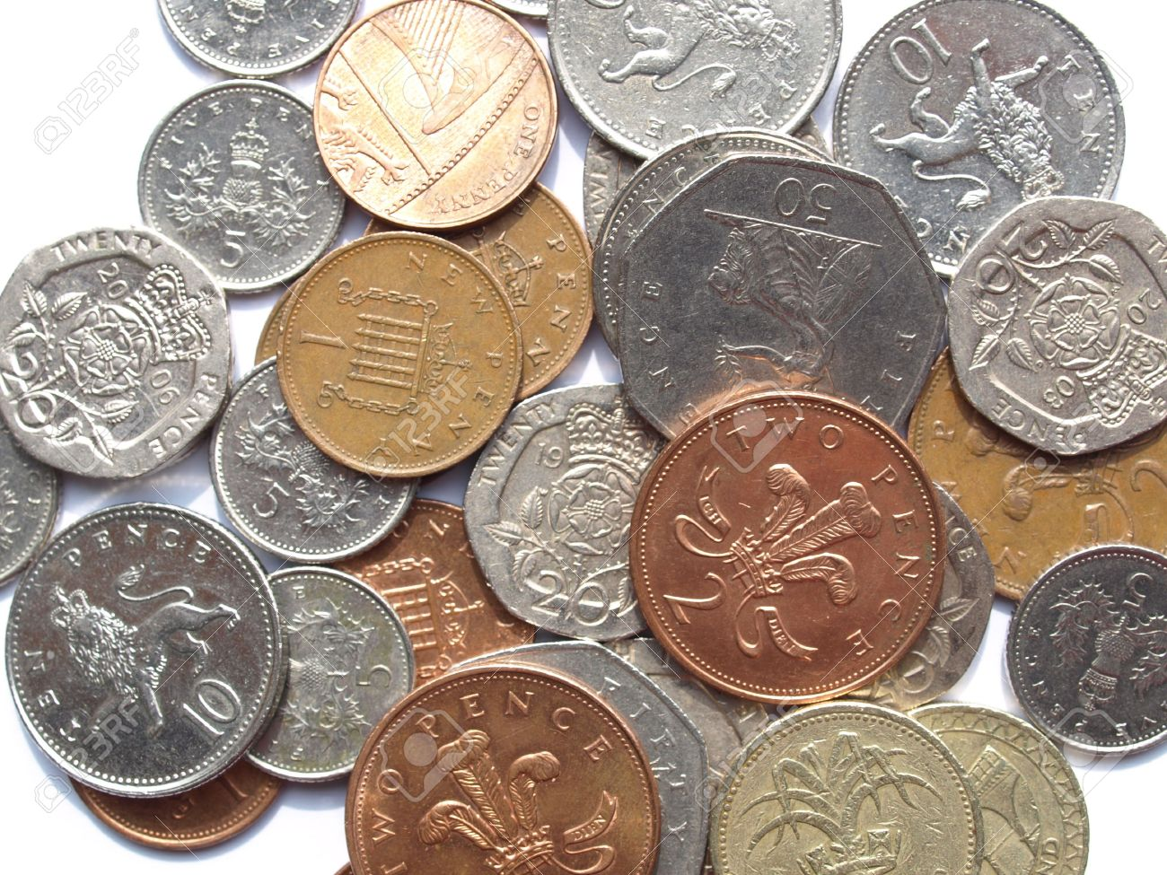
Loving our community!
[Paste in photo of school building and map of local area where school located]
What can our school do to help the community?
Can we raise any money for a good cause?

Slide 5


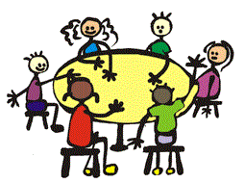
Have you got what it takes to be on the
School Council?
Are you bursting with ideas to improve our school and help our community?
Would you like to share your class’ ideas in our meetings?

Slide 6
What qualities does a School Council Representative need?
A School Council rep needs to be:
Organised
Caring
Hardworking
A good listener
Communicate ideas and opinions clearly
Responsible
Considerate
Committed
Willing to give up some of their break and lunchtimes to prepare for events

Slide 7
Your Manifesto
If you are interested in becoming a School Council rep, you must write a manifesto.
This is a presentation which explains your personal qualities and why you feel you would make a good School Council member.
You could also include ideas regarding future purchases, events or activities the Council could participate in or perhaps ways in which the Council could be involved in developing and improving our school.
You will be asked to read your manifesto to your class so you should try to practise reading it at home.

Slide 8
What happens on Election Day?
Every member of your class will vote for one person who they think would make a good School Council rep.
The two children who receive the highest number of votes will become the new School Council reps for their class.

Slide 9
DATES TO REMEMBER
Start planning and writing your manifestos as soon as possible
W/c 11th October - read your manifestos to the rest of your class
Friday 15th October – School Council Elections during registration
Monday 18th October - School Council ‘Welcome Meeting’ lesson one.

Slide 10
School Council
If you have any questions or queries do not hesitate to come and speak to Mrs Rudd.
Wishing you lots of luck and very best wishes!

