Slide 1
WALT (We Are Learning To): Experiment with changes to a sprite
Boo!
A project our visiting Year 4s normally complete on open evening.
Sadly, we can’t welcome you into one of our superb ICT suites this year for open night. However, you could try the task we normally try at school in your own home.
All you need is access to Scratch online. You can follow the instructions on slides 2 to 9. The slides we use on open evening to show you what to do are on slides 10 to 18.
Happy coding!
(And watch out for those ghosts! Mwahahahaha!)

Slide 2
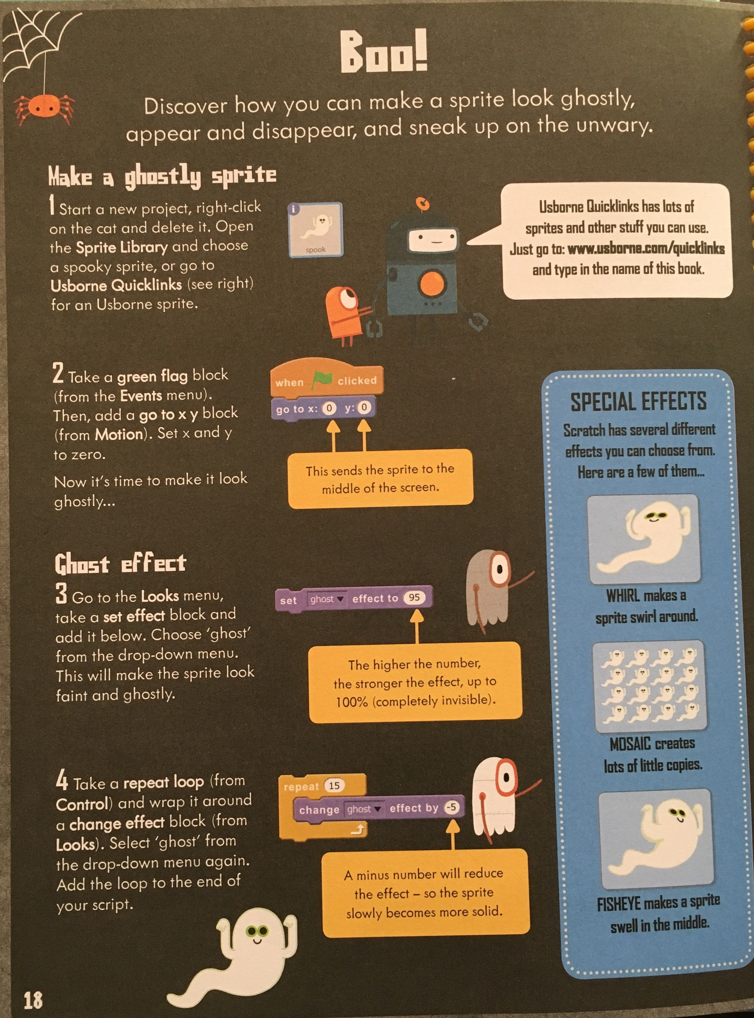

Slide 4
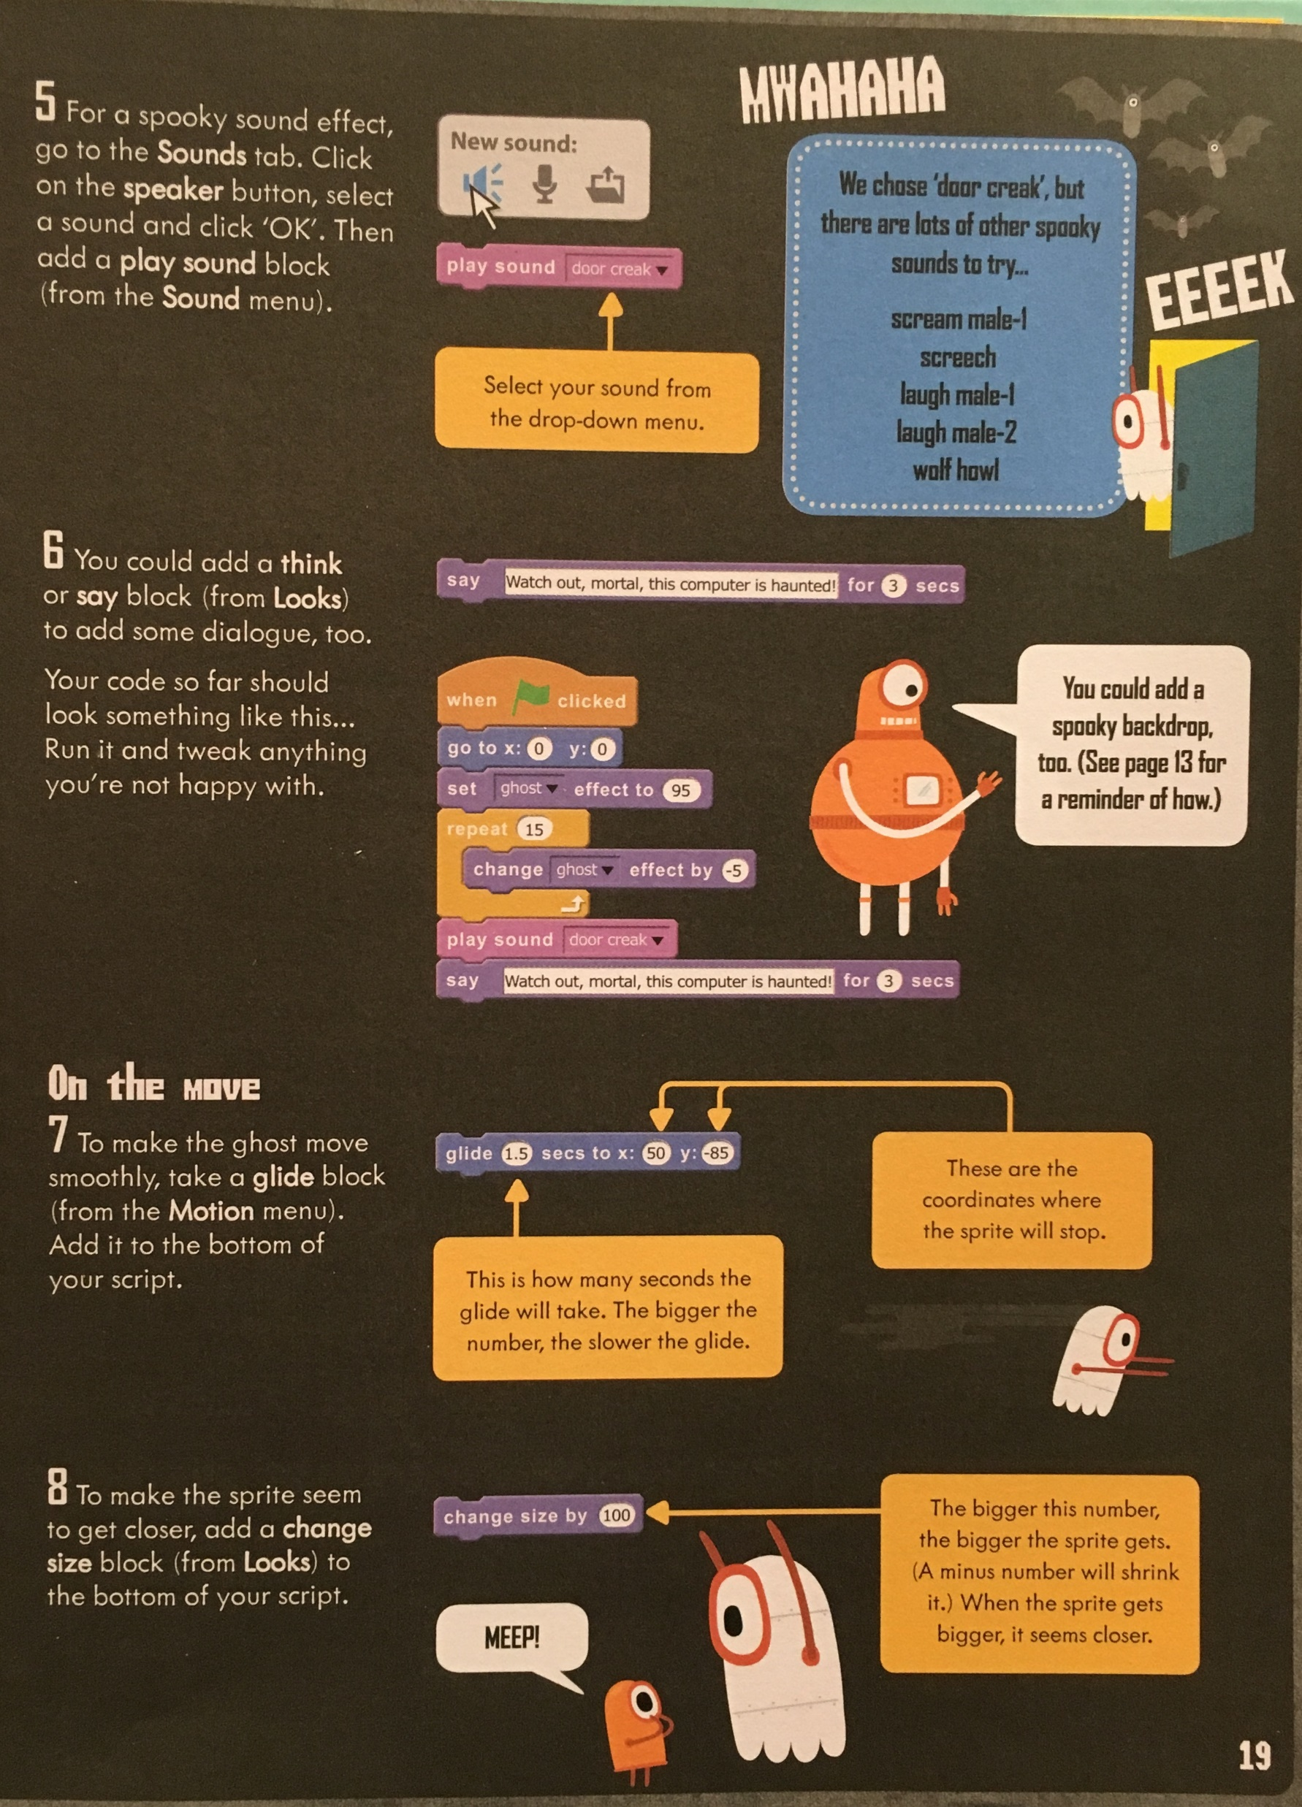

Slide 6
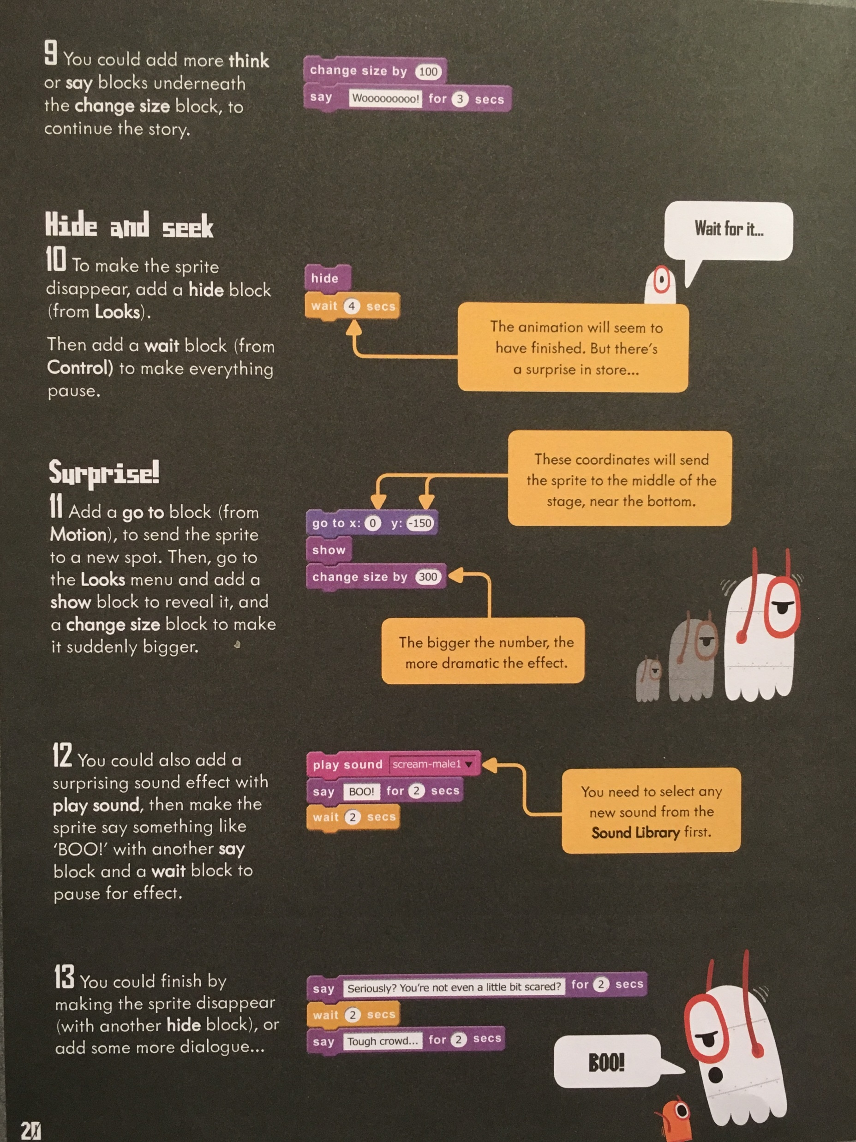

Slide 7


Slide 8
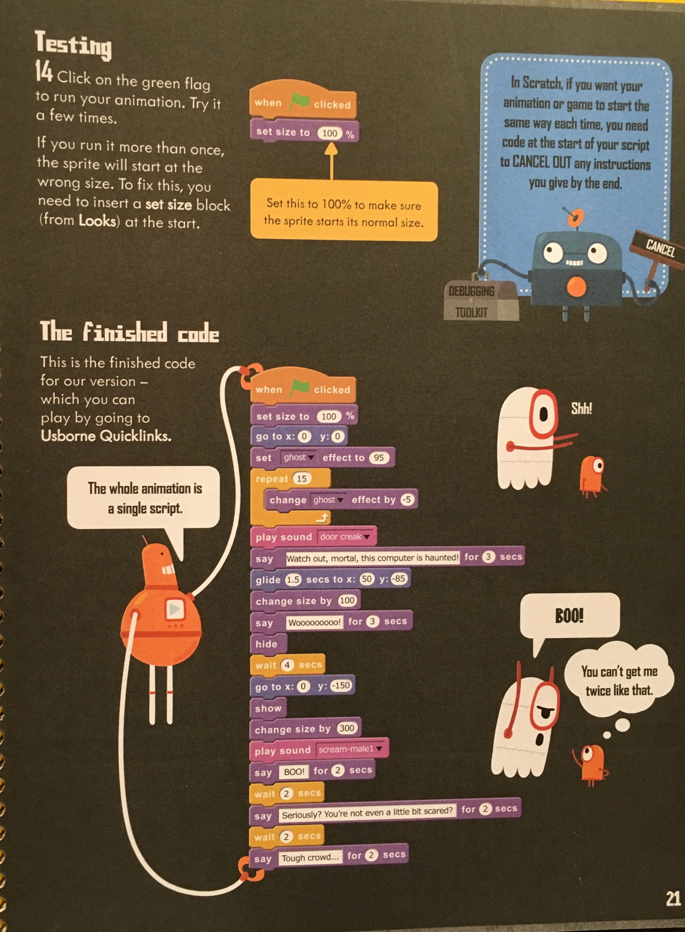

Slide 9


Slide 10
Part 1
1 - How to change sprite
2 - How to send the sprite to the middle of the screen.
3 - How to change the invisibility of your sprite.
4 - How to use a repeat loop to get the invisibility to reduce to zero.
5 - How to add sound effects
6 - How to get the sprite to say something.
7 – How to get the sprite to move somewhere to a place on the screen.
8 –How to make the sprite seem to get closer.

Slide 11
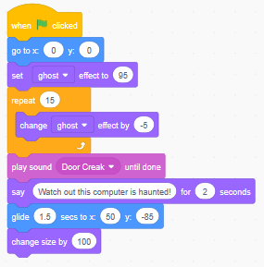
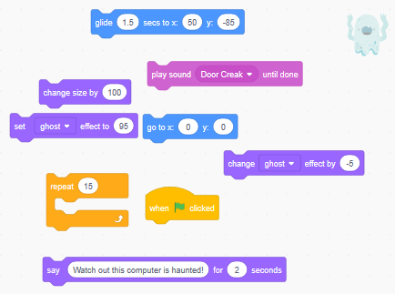
Bronze task 1 – Copy the code below.
Try a different spooky sound if you want!
Here are the pieces you will need:
Get the sprite to say something else spooky if you like!
When you’re done go to the challenge on Slide 5 (Gold Task)

Slide 12
Silver task 1 – Copy the task below.
Follow the written instructions to make the code on Slides 12 – 15.
When you’re done go to the challenge on Slide 5 (Gold Task)

Slide 13

Gold task 1 – Get these pieces together and put them in order to make what you saw the teacher demonstrate!
CHALLENGE – 1) Change your background to spooky one! 2) Put in more code so that the ghost glides for 4 seconds to X = 50, Y = 85, then glides for 3 seconds to X = 0, Y = 85, then glides for 2 seconds to X = -85, Y = 0. 3) Play around with the movement of the ghost. Can you make your ghost move around in a clockwise direction? Got an idea for another challenge? Let Mr S know!

Slide 14
Part 2

Slide 15
Part 2
9 – How to get the sprite to say something more.
10 – How to make the sprite disappear.
11 – How to get the sprite to go to a position and change size.
12 – How to include a surprising sound effect along with the sprite saying something.
13 - How to add more dialogue.
14 – How to make sure your sprite starts at the right size and how to test out your code.

Slide 16
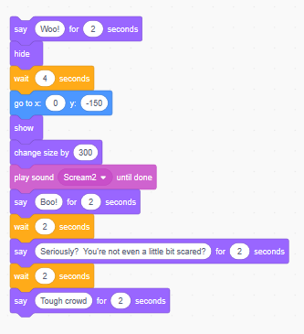
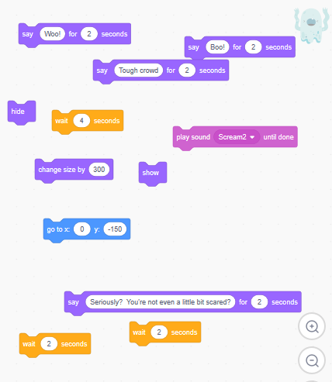
Bronze task 1 – Copy the code below and add it to what you already have:
The pieces you will need are:
The bigger the number the more
dramatic the effect!
Choose a different spooky sound if you want!

Slide 17
Silver Task 2
Follow the written instructions to make the code on slides 21 to 24.
When you are finished, go to the challenge on Slide 10 (Gold Task)

Slide 18

Gold Task 2 - Get these pieces together and put them in order to make what you saw the teacher demonstrate!
Challenge – Now your code is all ready, change the gliding so that your ghost starts in the top middle and moves to the far right middle, then the bottom middle and then the far left middle before settling back down in the middle where it started.

Slide 19
WALT: Experiment with changes to a sprite

