Slide 1
English
At Gosforth East Middle School

Slide 2
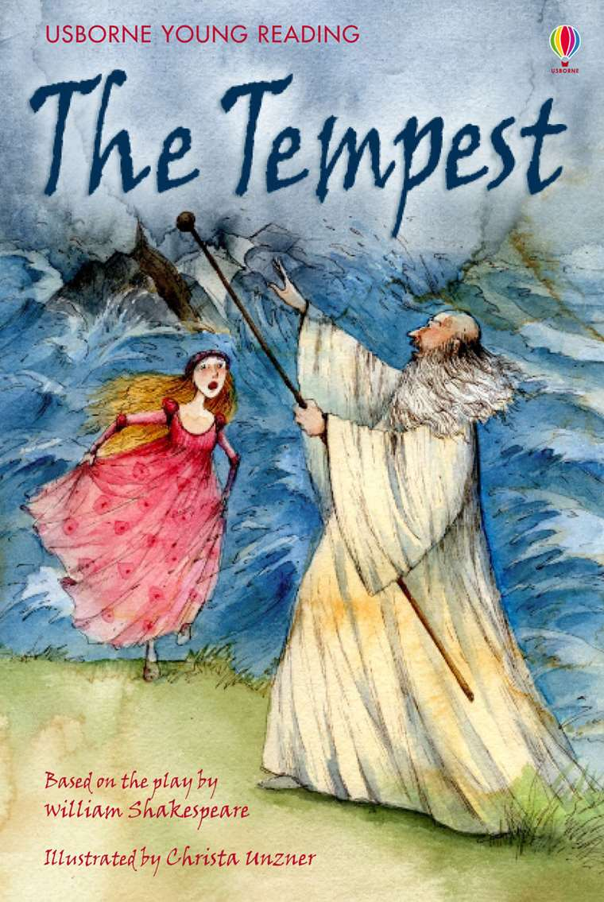
How many lessons will we have?
Six lessons of English per week in Year 5 and Year 6
  Weekly school library visit
  Guided reading every week
Four lessons of English per week in Year 7 and Year 8
  Fortnightly visit to school library
  Fortnightly writing challenges

Slide 3
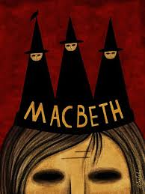
Are pupils taught in sets for English?
We focus on mixed ability teaching in English and we are proud that we can provide smaller class sizes for English.
In Year 5 and Year 6 we have six English classes in each year group. Pupils are mainly taught in mixed ability form classes by their form teacher with the exception of a challenge group and a nurture group in each year.
In Year 7 and Year 8 the majority of pupils are taught in mixed ability classes across six groups in each year and we continue to have nurture groups to support some pupils with additional needs.

Slide 4
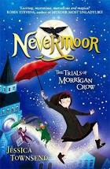
What will we read?
We read a variety of texts of increasing difficulty including novels, plays, poetry, short stories and non-fiction. Texts are used for reading comprehension, reading analysis and as examples for producing high quality writing. We have a great selection of texts. Here are just a few:
Nevermoor Macbeth
Toro Toro Wolf Brother
The Tempest Much Ado About Nothing
Animal Farm Oliver Twist
Skellig Pig Heart Boy
The Machine Gunners Of Mice and Men
Romeo and Juliet Sherlock Holmes stories

Slide 5

What trips may we go on?
We usually enjoy the theatre as well as going to see writers and having authors visit us in school. Many writing and drama workshops usually take place and we enter the Lit Quiz each year.
Michael Rosen at The Theatre Royal
The Merchant of Venice at The Northern Stage
BBC News Centre Trip
Literature Works

Slide 6

What English clubs do we have?
We have book clubs for each year group and we have a press club.
Each book club meet weekly to discuss the books and share their love of reading. Some of the most enjoyed books include Boy in the Tower, The Nest, Smart, Looking at the Stars, Ghost Boys, Jessica’s Ghost and A Monster Calls.
Press Club work with Mrs Leahy to report key events happening at our school and they produce the school newsletter each half term.

Slide 7

What homework is set?
Pupils will be given three homework tasks to complete each week:
Reading comprehension
Grammar, punctuation and spelling work
Spellings for a weekly spelling test

Slide 8
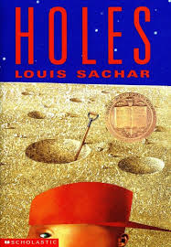
What tests will we do?
KS2
Half termly tests in reading comprehension, GPS (grammar, punctuation and spelling) and a spelling test using a mix of Rising Stars assessments, Testbase, CGP and past SATs papers
Two assessed pieces of writing each half term
KS3
Half termly assessment of writing and assessment of reading analysis skills
Termly AQA KS3 practice papers for reading and writing

Slide 9
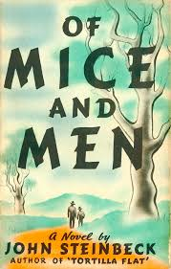
How do you encourage Writing across the curriculum?
Numerous training sessions in-house and from external providers, including Pie Corbett and Alan Peat for all staff.
Writing for a range of audiences and purposes include real life examples across subjects every half term.

Slide 10

Any further questions?
Please ring Mrs Collister, Head of English, if you would like to find out more about English at Gosforth East Middle School.
We look forward to seeing you soon!

